Slide 1

British Airways Virtual Experience
Customer Review Sentiment Analysis
By Ayaan Danish

Slide 2

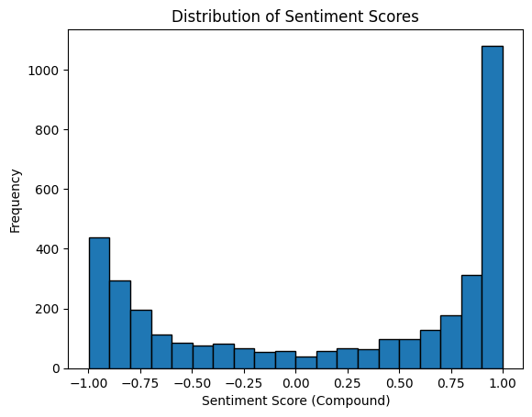
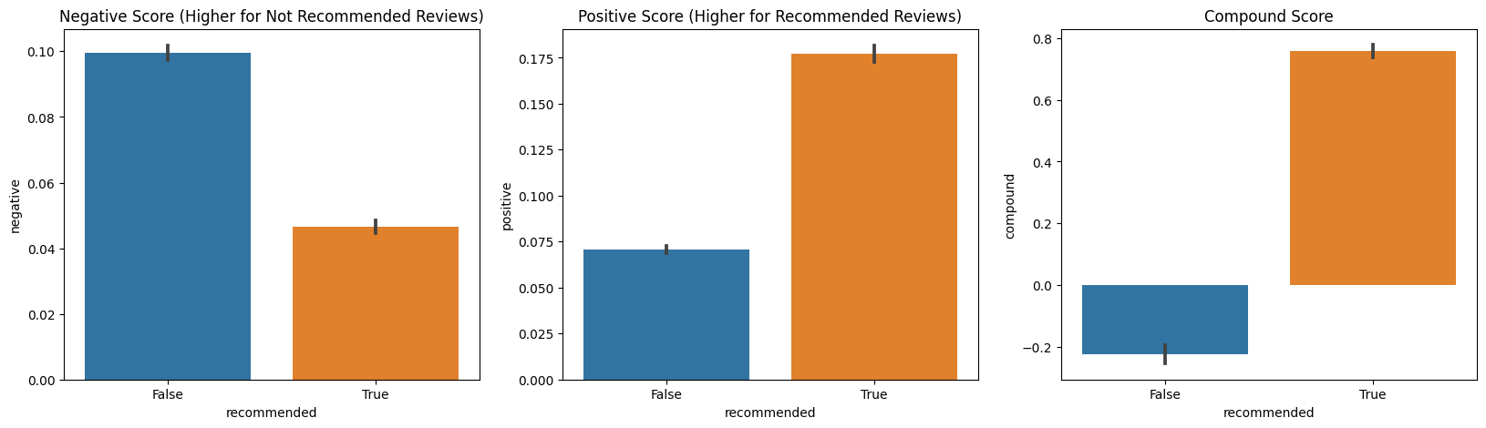
Findings and Insights
Fig. 1: A word cloud summarizing the overall sentiment expressed in all the airline reviews, with larger words being more frequently used.
Fig. 2: Sentiment score distribution, ranging from -1 (negative sentiment) to +1 (positive sentiment). The figure shows a high frequency of positive reviews.
Fig. 3: Positive and negative sentiment scores (0 to 1), as well as the compound scores (-1 to +1) plotted against whether the customer would recommend BA or not (also scraped from SkyTrax).
Showcases the correctness of the sentiment analysis model.

